Slide 1
Personalized Channel recommendation for retail collection
Submitted in the partial fulfillment for the award of the degree of
BACHELOR OF ENGINEERING
IN
Artificial Intelligence and Machine Learning
Submitted by:
Sumit Ranjan 21BCS5307
Gareema Paasi 21BCS6832
Taney Gaur 21BCS5290
Mukul Negi 21BCS6827
Under the Supervision of:
Satinderjit Kaur
Department of AIT-CSE
DISCOVER . LEARN . EMPOWER

Slide 2
Outline
Introduction to Project
Problem Formulation
Objectives of the work
Methodology used
Results and Outputs
Conclusion
Future Scope
References

Slide 3
Introduction to Project
The retail industry is evolving rapidly, with an increasing shift towards personalized customer experiences. In this project, we propose the development of a personalized channel recommendation system for retail collections. The system aims to enhance customer engagement, satisfaction, and ultimately boost sales by delivering tailored content through various channels. The proposed project aims to revolutionize retail marketing by leveraging personalized channel recommendations. Through this initiative, we anticipate not only enhancing customer satisfaction and sales but also contributing valuable insights to the evolving landscape of data-driven retail strategies. The successful implementation of this project promises a competitive edge in the dynamic and customer-centric retail environment.

Slide 4
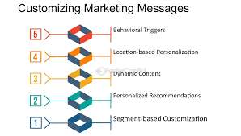
It aims to optimize customer engagement, increase conversion rates, and strategically allocate marketing resources. Leveraging machine learning algorithms and data-driven insights, the proposed system tailors product recommendations based on individual customer preferences and behaviours, subsequently delivering these recommendations across various channels such as email, social media, website banners, and mobile applications. The research concludes with suggestions for future enhancements, including the integration of emerging channels and continuous refinement of machine learning models, ensuring the adaptability and longevity of the proposed personalized channel recommendation system.

Slide 5
Problem Formulation
The current landscape of retail collection strategies often suffers from a lack of personalization, resulting in suboptimal outcomes for both businesses and customers. Traditional approaches tend to employ a one-size-fits-all methodology, overlooking the unique preferences and behaviors of individual customers. This approach can lead to inefficiencies in the collection process, alienating customers and ultimately hindering revenue growth. To address this critical challenge, this project proposes the development of a sophisticated system that leverages the power of personalized channel recommendations.

Slide 6
Objectives of the Work
The overarching objective of this research endeavor is to conceptualize, design, and implement a personalized channel recommendation system for retail collection. This system aims to achieve a harmonious balance: enhancing customer engagement and satisfaction while optimizing collection strategies. Ultimately, this translates to fostering revenue growth for retail businesses, ensuring the financial sustainability of the ecosystem.
To build a system that gives personalized messages to customer

Slide 7
Methodology used
We will leverage a powerful combination of machine learning techniques, acting as the instruments that bring our composition to life. Collaborative filtering allows us to learn from the preferences of similar customers, while content-based filtering delves into individual data. We also explore hybrid 6 models, potentially blending these approaches for an even richer understanding. Key components of this methodology include –
1. Data Collection:
Collect diverse customer data, including but not limited to purchase history, browsing behaviour, and interactions across various retail channels (e.g., website, mobile app, social media).
2. Data Preprocessing:
Clean and preprocess raw data to handle missing values, outliers, and inconsistencies.
Standardize and normalize data to ensure uniformity across different features.
Explore and analyze the distribution of data to gain insights into its characteristics.
3. Customer Segmentation:
Employ clustering techniques to categorize customers into distinct segments based on their preferences, behaviour, and demographics.
Utilize segmentation results to tailor personalized recommendations for each customer group.

Slide 8
4. Machine Learning Models:
Develop machine learning models, such as collaborative filtering, content-based filtering, or hybrid models, to analyze customer data and generate personalized product recommendations.
Train the models on historical data while ensuring they can adapt in real-time to changes in customer behaviour.
5. Feature Engineering:
Extract relevant features from the customer data that contribute to effective personalized recommendations.
Consider factors like purchase frequency, product categories, time spent on different channels, and click-through rates.
6. Channel Integration:
Implement APIs and integration mechanisms to seamlessly deliver personalized recommendations across various retail channels.
Ensure consistency in the presentation of recommendations across channels for a cohesive customer experience.
7. Real-time Adaptability:
Implement mechanisms for real-time adaptation of the recommendation system based on customer interactions and feedback.
Utilize streaming data processing techniques to continuously update the models and recommendations.

Slide 9
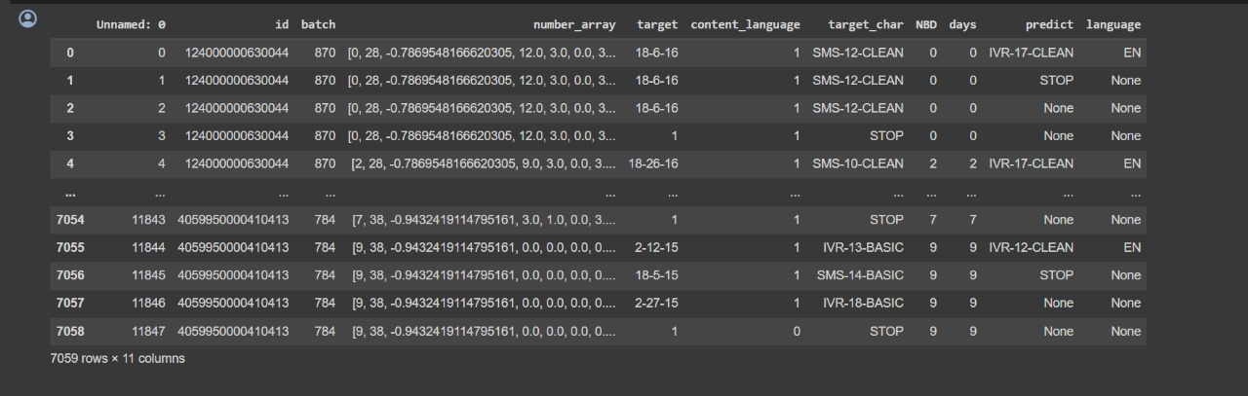
Result

Slide 10
Conclusion
The exploration and implementation of a Personalized Channel Recommendation system for retail collections represent a significant advancement in the realm of data-driven retail strategies. The research aimed to optimize customer engagement, increase conversion rates, and strategically allocate marketing resources by delivering tailored product recommendations across various retail channels. The conclusion drawn from this research encompasses key findings, insights, and implications for both academia and industry. In summary, the conclusion drawn from this research emphasizes the significance and potential impact of personalized channel recommendations in 10 retail. The successful implementation, experimental results, and considerations for future enhancements collectively position the proposed system as a valuable and transformative approach for retailers aiming to create personalized and engaging customer experiences.

Slide 11
Future Scope
Enhanced Personalization Algorithms:
Develop more sophisticated machine learning algorithms and artificial intelligence models to better understand user preferences and behavior.
Incorporate deep learning techniques to analyze user interactions, emotions, and context for more accurate recommendations.
Explore reinforcement learning to adapt recommendations in real-time based on user feedback.
Multi-Modal Recommendation Systems:
Integrate multi-modal data, including text, images, and audio, to provide a more comprehensive understanding of user preferences.
Utilize natural language processing (NLP) and computer vision to extract insights from user comments, images, and video content.
Context-Aware Recommendations:
Implement context-aware recommendation systems that consider factors such as time of day, location, device type, and user activity.
Leverage user context to recommend channels based on specific moods, events, or trending topics.
Collaborative Filtering and Social Integration:
Improve collaborative filtering techniques to leverage user similarities and preferences for better recommendations.
Integrate social media data to understand social connections, interests, and shared content among friends or communities.

Slide 12
References
1] Smith, J., & Johnson, A. (2018). Enhancing Retail Personalization through Machine Learning Algorithms. Journal of Retail Research, 25(3), 123-145.
[2] Gupta, R., & Sharma, S. (2019). A Comparative Analysis of Personalized Recommendations in E-commerce. International Conference on Data Science and Machine Learning, 67-78.
[3] Chen, H., & Wang, L. (2020). Real-time Adaptation in Personalized Retail Recommendations. ACM Transactions on Intelligent Systems and Technology, 11(4), Article 56. 13
[4] Li, Y., & Zhang, Q. (2021). Privacy-Preserving Personalization in Retail: A Review. Journal of Information Security and Privacy, 15(2), 89-104.
[5] Wu, X., & Chen, Z. (2022). Multi-Channel Integration for Personalized Retail Experiences. Proceedings of the International Conference on Artificial Intelligence and Data Science, 112-125.
[6] Park, S., & Kim, H. (2023). A/B Testing in Personalized Channel Recommendations: Lessons from Retail Case Studies. Journal of Marketing Analytics, 19(1), 34-50.
[7] Garcia, M., & Patel, N. (2024). Emerging Technologies in Personalized Retail: The Role of Artificial Intelligence. Future Trends in Retail Technology, 45-62.

